Slide 1
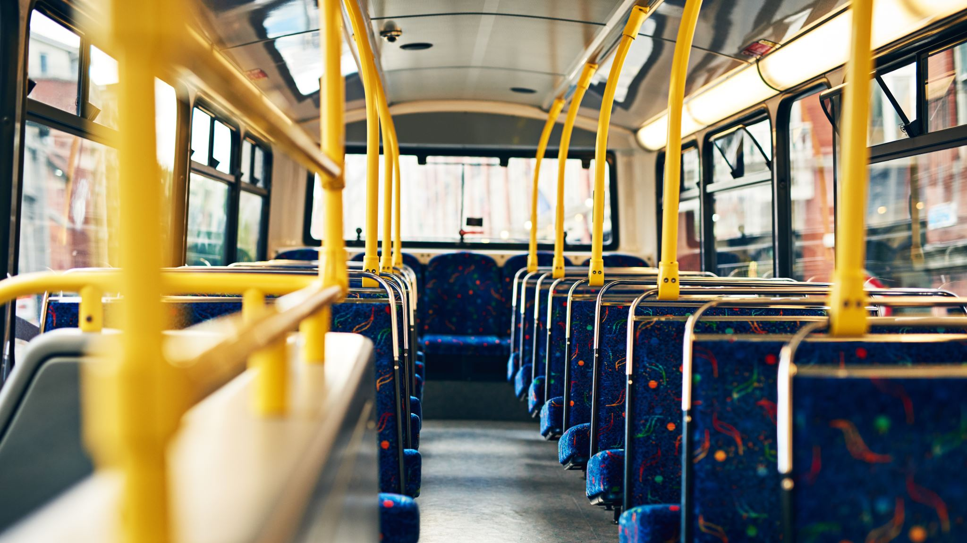
Optimizing Public Transportation in Järfälla Municipality Through AI-Driven and Multimodal Transport Solutions
Addressing Transportation Challenges with Sustainable, AI-Powered Solutions
Friday November 8, 2024
By Nick Bwalley.

Slide 2

AIM AND SCOPE
AIM
To analyze how AI-driven real-time data analytics and multimodal transport solutions, such as call-based buses, can optimize Järfälla’s public transport system by improving efficiency, accessibility, and sustainability.
To reduce private car dependency and emissions, aligning Järfälla’s transportation goals with the Sustainable Development Goals (SDG) 11 (Sustainable Cities and Communities) and SDG 13 (Climate Action).
SCOPE
Investigate the effectiveness of AI-driven solutions in resource allocation within Järfälla’s public transport, focusing on peak and off-peak demand management.
Explore the potential of integrating flexible multimodal options to enhance service accessibility and environmental sustainability.
Demonstrate how smart transport solutions can contribute to Järfälla’s vision of a cleaner, more accessible, and efficient suburban transport network.

Slide 3

OBJECTIVES.
Align with SDGs: Specifically, SDG 11 (Sustainable Cities and Communities) and SDG 13 (Climate Action).
Efficiency: Use real-time data and AI to reduce congestion and improve scheduling accuracy.
Accessibility: Ensure all areas, including low-demand ones, are covered through dynamic, on-demand services.

Slide 4
PERSPECTIVES CHOSEN.
Solution-Based Approach for Järfälla’s Transport Inefficiencies
AI-Driven Real-Time Data Analytics: Adapts schedules dynamically to demand patterns, optimizing resource allocation and enhancing reliability.
Example: Used in New York to manage congestion and lower energy consumption.
Call-Based Bus Services: Operate on-demand in low-use areas, guided by predictive analytics.
Benefit: Reduces fuel consumption and emissions.
Multimodal Transport Integration: Expands travel options, reducing car dependency and supporting Järfälla’s environmental goals. (active transportation, trains and buses sync reduce waiting time), Metros and other modes of transportation

Slide 5

THEMES OF SYNTHESIS
It's about identifying shared insights or common approaches from different studies and showing how they connect to your topic.
1. AI-Driven Efficiency: Many studies highlight that using AI in transport (like real-time data analytics) improves efficiency by adapting to demand, reducing congestion, and enhancing reliability. Hence, AI can help Järfälla optimize bus schedules and routes.
2. Demand-Responsive Transport: Research shows that on-demand, or call-based, transport reduces emissions and is cost-effective in low-demand areas. This theme suggests that Järfälla could use call-based buses to serve neighborhoods with fewer commuters, reducing fuel use and environmental impact.
3. Multimodal Integration: Studies emphasize that integrating various modes (e.g., buses, trains, bikes) offers flexibility, decreases car dependency, and supports sustainability. This theme fits Järfälla's needs by suggesting a seamless network that encourages residents to switch between transport modes easily.

Slide 6

CONCLUSIONS.
AI Enhances Efficiency AI-driven data analytics can optimize schedules, reduce wait times, and lower congestion.
On-Demand Services Cut Emissions Call-based buses in low-demand areas save fuel and reduce emissions.
Multimodal Integration Reduces Car Dependency Combining buses, trams, and trains with AI decreases reliance on private cars.
Global Success Stories Provide Models New York, Singapore, and London offer valuable AI transport solutions applicable to Järfälla.
Opportunities for AI Integration in Järfälla Expanding real-time AI in Swedish transport can improve service efficiency.
Supports Sustainable Development Goals AI and multimodal solutions align with SDG 11 and SDG 13 for a sustainable future.

Slide 7

THANK YOU

